Slide 1
02/02/2016
Digital Data & Analytics
Tata Insights and Quants
The information contained in the document is proprietary to Tata Insights and Quants Division, Tata Industries Limited and is strictly confidential. In consideration of receipt of this document, the recipient agrees that the information is being shared only for the limited purpose. The recipient of this information further agrees to maintain such information in confidence and to not reproduce, disclose, duplicate, electronically transmit or use in whole or in part for any other purpose. Prior written consent shall be obtained from the Consumer Analytics Division of Tata Industries in case the information is necessitated to be shared with anyone other than the Recipient to whom this information is addressed. The above restriction shall not limit the right to use the information contained in this deck, if it is obtained from another source without restriction. © Copyright, Tata Insights and Quants Division, Tata Industries Limited

Slide 2
What should you demand from Digital?
Confidential Property of Tata Insights and Quants Division, Tata Industries Limited
being digital means being closely attuned to how customer decision journeys are evolving in the broadest sense. That means understanding how customer behaviors and expectations are developing inside and outside your business, as well as outside your sector, which is crucial to getting ahead of trends that can deliver or destroy value.
an obsession with understanding each step of a customer’s purchasing journey—regardless of channel—and thinking about how digital capabilities can design and deliver the best possible experience, across all parts of the business
Automation of customer interactions can boost the number of self-service options that help resolve problems quickly, personalize communications to be more relevant, and deliver consistent customer journeys no matter the channel, time, or device.
Notes:
https://xkcd.com/539/

Slide 3


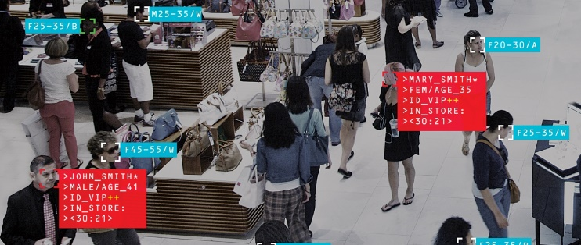
The Potential of Digital Data
While gathering offline data has its own challenges, the Digital footprints that visitors leave are relatively easier to capture, unleashing a world of possibilities
Data that can be captured is the equivalent of having foot sensors and facial recognition in your stores
An offline purchase captures:
Transaction details (products, value)
Demographics (Name, Age etc. if a Loyalty Customer)
An online visit or purchase on your website has the potential to capture :
Which products were “considered”
What were the pages visited just before the purchase was triggered?
Demographics (Name, Age etc. if the customer logs in)
Transaction Details (products, value)

Slide 4
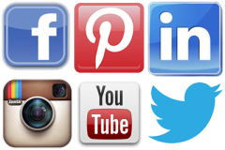

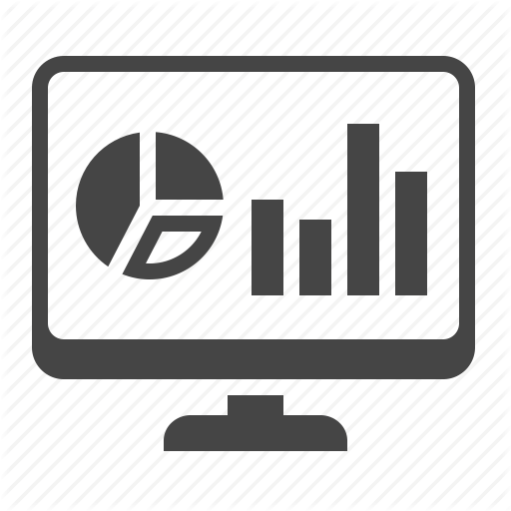
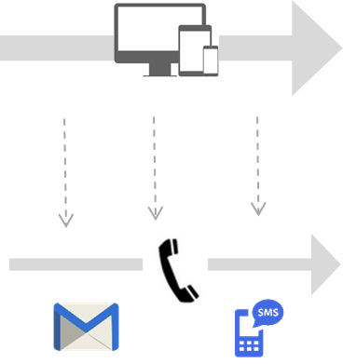
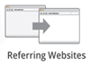
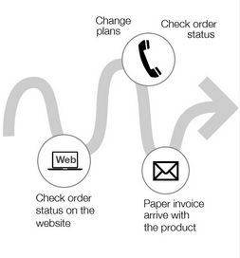
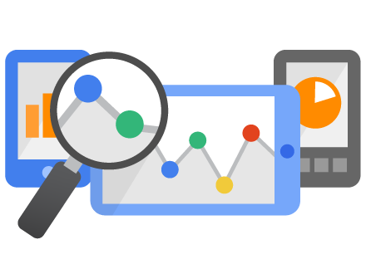
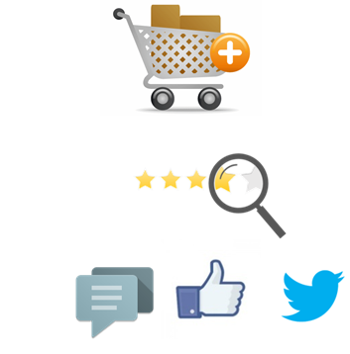
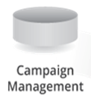

Analytics across the Customer Life cycle
Generating “Word Clouds” - Positive & negative sentiments
Awareness
Consistent offer & message
Social Media Sentiment Analysis
1
Social Media
Awareness
Display Campaign, Branding, Brand Bidding,
2
Engagement
Promote & Persuade
Web Logs
Engagement
Attribution, Fall-out, Online Persona
3
Multi-variate testing, A/B testing, SEO, Pathing, Contextual Offering
Conversion
Personalize & Convert
Conversion
Micro targeting, Digital usage & product propensity, Recommender Engine
Multi-device Data
4
Passions, Interest, Leads, Offer Redemption, Contextual offers
Loyalty
Increase satisfaction & value
Loyalty
Event driven marketing (Triggers), Market basket, Web page redesign
Customer Transaction
Confidential Property of Consumer Analytics Division, Tata Industries Limited

Slide 5

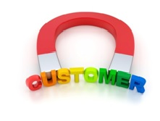



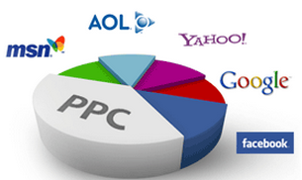

Digital Analytics Landscape
Objective
Increase in Brand Awareness
Retain Existing Customers
Lead/Prospect Generation
Sale/Profit Improvement
Analytics
Customer Segmentation
Attribution Modeling
Text Mining
Forecasting
Lead/Prospect Scoring
Lookalike Modeling
Message Scoring
Event Triggers
CTR Models
Pathing
Design of Experiments
Pricing
Channels
Website/Email/Mobile
Social Media/Video/Webcast
Search/Paid AdWords
Confidential Property of Consumer Analytics Division, Tata Industries Limited

Slide 6
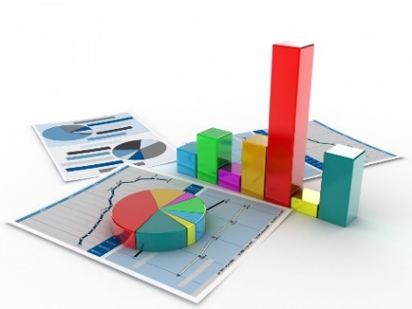

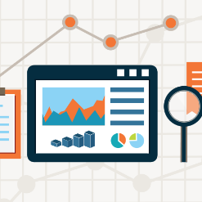
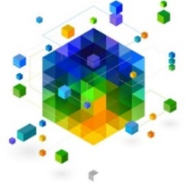


Connecting Across Various Brand Touchpoints
Confidential Property of Tata Insights and Quants Division, Tata Industries Limited
5
Web Analytics
4
Mobile App Analytics
Performance of your website
Behaviour of visitors
to your website
Performance of your mobile app
Behaviour of app users and
Interaction with the brand
1
Tata iQ
An Integrated View
of your Customer’s behaviour
Develop a view across both
offline and online data
Campaign
Management
2
3
Social Media Analytics
Interactions on social media platforms
Understand key influencers,
sentiment and trends
Offers, Target population, List creation, execution, response rate & channel optimization

Slide 7
Web Analytics

Slide 8
Tata Companies have begun to attract visits to their websites
Confidential Property of Tata Insights and Quants Division, Tata Industries Limited
5.8 %
Questions Tata Companies are asking
How do we create an Online Presence that visitors would love to visit?
How do we drive traffic to our websites in an optimal manner?
How do we optimize our website to provide an engaging experience?
1.25 B
1.34 B
99 %
India
0.55 B
41%
Internet Active
? %
Tata Online
0.28 B
22%
20 M
2015
2020
But have barely scratched the surface

Slide 9
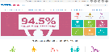





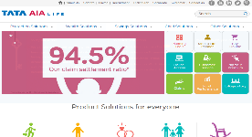





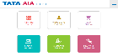
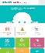
Optimize your Website…
Confidential Property of Tata Insights and Quants Division, Tata Industries Limited
Drive Web Traffic
Engage the visitor online & Drive Conversions
Develop your web presence
3
1
2
1. Digital Showroom - Showcase your Brand
1. Leverage Sources to Drive Visits
1. Measure & Monitor Visits and Engagement Parameters
2. Identify the most effective sources of traffic
2. Give the Visitor a Brand Experience
2. Optimize the site to
Enhance Experience and Drive Conversions
3. Design for a website suitable for Mobile views
3. It’s not an IT Project
…Through a three pronged strategy to drive results

Slide 10
1. Develop Your Web Presence

Slide 11
2. Drive Web Traffic

Slide 12
2a. SEO / SEM

Slide 13
2b. Display Ads

Slide 14
2c. Referrals

Slide 15
3. Drive Conversions
Website Optimization

Slide 16
Mobile App Analytics

Slide 17

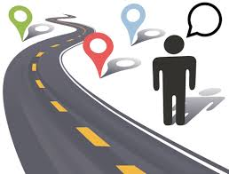



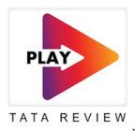


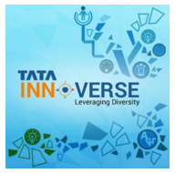


Mobile App Analytics
Optimize the performance of Mobile Apps to enable a deeper engagement with users, while improving their experience
1
User Flow Analysis
2
User Action Analysis
In “List View”, only 5% of users view stories that are below the first three
In “Tile View” that number goes up to 45%
95% users logging in through their LinkedIn Account continue. It takes them 30s to log in
45% users logging in through their App Account continue. It takes them 1 min to log in
User Retention Analysis
3
85% of ‘dormant’ users come back to the app to view a GEC message
50% of these continue to use the app for the next 3 months
“Mr. GEC speaks about the growing attractiveness of Africa” to dormant users
“Our new design makes viewing stories easier!” to active users
Targeted messaging
4
User Segmentation
5
Half the users are dormant after 3 months
But only 10% of international users are dormant

Slide 18
Case Study

Slide 19
Social Media Analytics

Slide 20
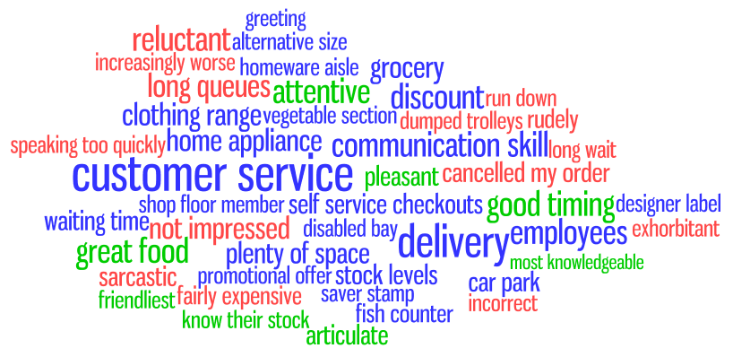
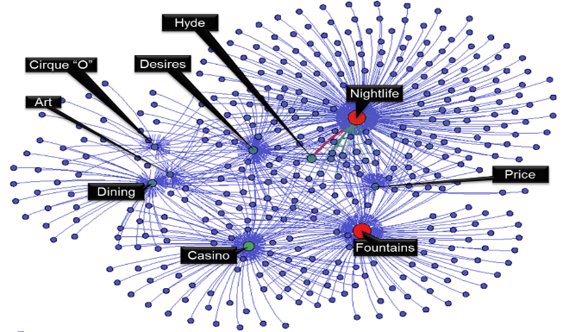
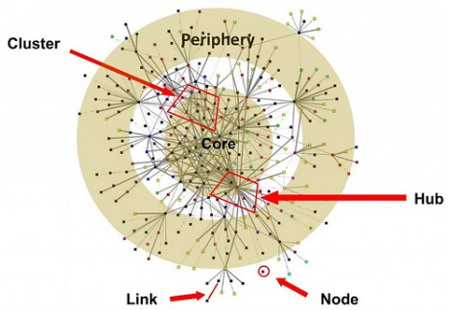
Social Media Analytics Techniques and Applications
Key social media analytic techniques enable data capture, comprehension and presentation
Sentiment Analysis
Techniques
computational linguistics
natural language processing
text analytics
Word Counts
Polarity lexicons
Applications
market predictions/trends
product defects
crisis management
reputation management
Topic Mining
Applications
user interest discovery
summarizing text collection
emerging topic detection
Techniques
algorithms for continuous data feeds
text mining
machine learning & Latency
word frequency and position
Network Analysis
Applications
social network dynamics and growth
key influencers in campaigns
campaign targeting, tailoring products and marketing materials
Techniques
nodes and association analysis
network density
predictive modelling
Source : Unveiling the power of social media analytics – Weiguo Fan and Michael D Gordon
Confidential Property of Consumer Analytics Division, Tata Industries Limited

Slide 21
Social media analytics also drive business decisions
Measuring ROI and business impact of Social Media on business metrics is difficult. Distributed Lag Modelling may help address the challenge
Design & Development
Production & launch
Decline
Utilization
Sales Volume
Campaigns
Decreasing campaign efficacy may forecast decline
Time lag for campaign to impact sales
Time
Design Risks : Trend &
Sentiment Analysis
Technology Gap Risk:
Topic Mining & Co-creation
Supply Chain Responsiveness : Visual Analytics, trend analysis
Competitor Analysis : Topic mining
Promotion, Awareness, Engagement :
Network Analysis, Visual Analytics, trends
Customer Relationship Management:
Sentiment Analysis , Topic Mining,
Disposal & Replacement :
Sentiment Analysis
Topic Mining
Confidential Property of Consumer Analytics Division, Tata Industries Limited

Slide 22
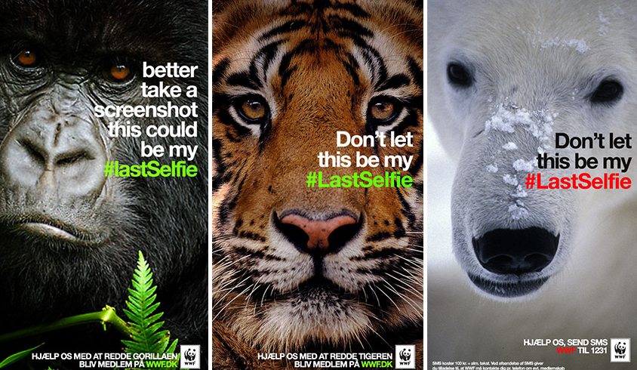
Case Study - Match Campaign to Platform
‘World Wildlife Fund’ effectively used Snapchat’s message self-disappearing functionality and ‘Selfie’ Trend, to put forward the message of extinction of some animals. This lead to increased donations on website.
Business Goal : Receive Online Donations
Social Platform Used : Snapchat
Campaign Idea : Ads that came up were only visible for a few seconds, and then they were gone forever, hinting at the possibility of endangered animals disappearing for good if they go extinct.
Result : WWF reached monthly donation goal within 3 days of campaign launch
http://www.justforthis.com/

Slide 23
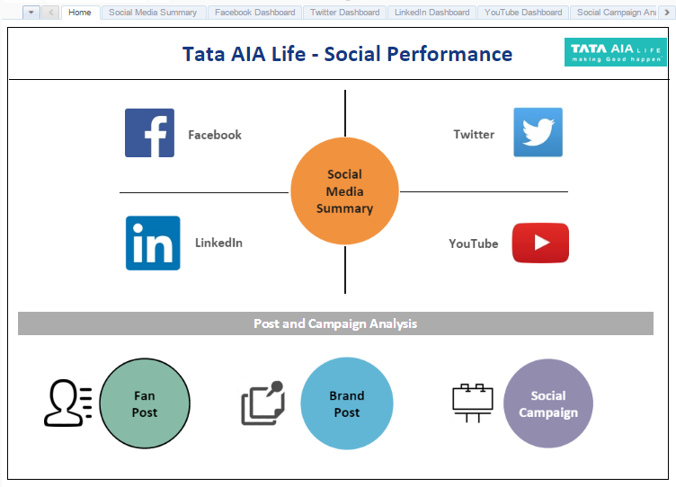
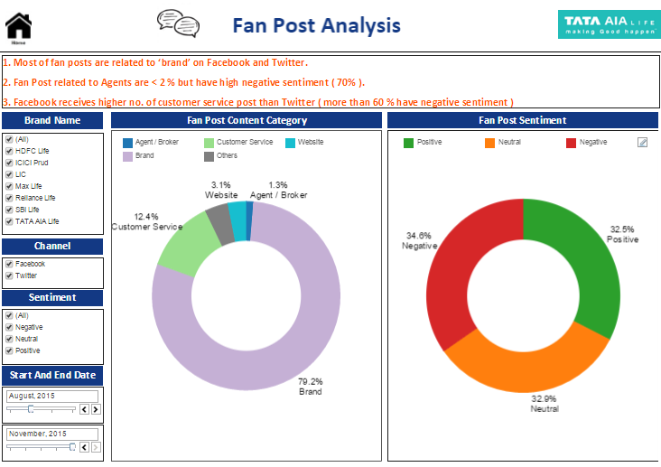
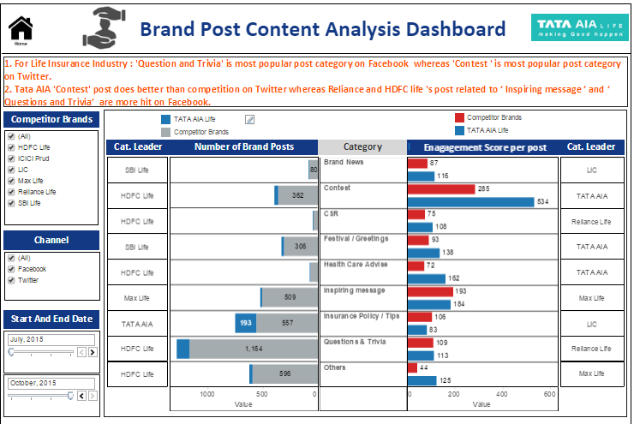
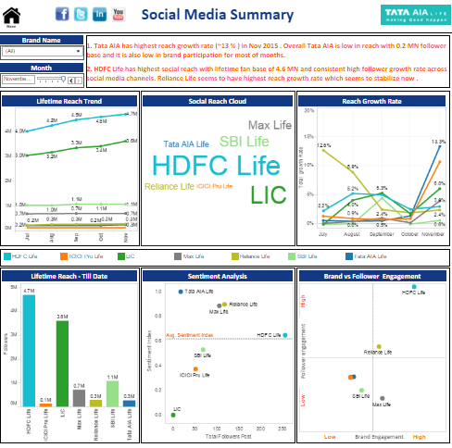
Case Study – Social Analytics : Tata IQ Client
Key services and results of social media analytics for a large financial client by TataIQ are shown below
Social Media Analytics across FB, Twitter, YouTube & LinkedIn
Key Results of Client’s Performance
Competitor Benchmarking
Topic & Sentiment Analysis
Highest growth in social reach in Industry for 2 subsequent months
1
Significant reduction in response time to Followers
2
Brand Content Analysis
Social Campaign Performance
Enjoys high positive Sentiment among direct competitors
3

Slide 24
Campaign Management

Slide 25


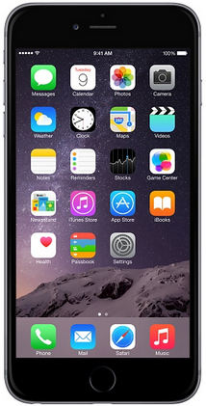


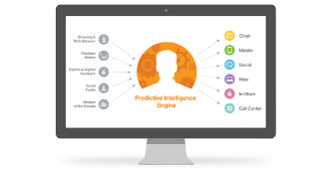


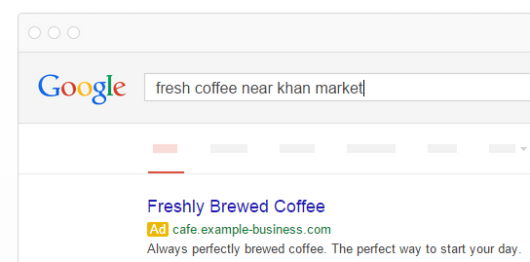




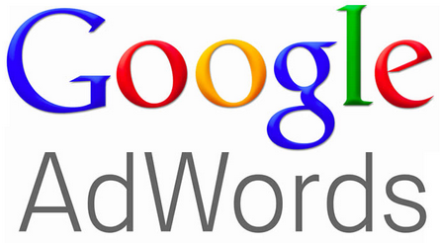




Campaign Management
Campaign Types – Event Trigger, Batch, Service. Channel Types– Owned, Paid and Earned Channels
Campaign Channels
Campaign Types
Owned
Event Driven
Targeted
Website
Email
Payment
Confirmation
Cart
Abandonment
Bundled
Offering
Reminders for
Registered Customers
Personalization
Paid
Shipping
Notification
Search & Display Ads
Seasonal, flash
Sale
Retargeting
SMS
Search based
Earned
Event based
Offerings
Product
Ideation
Every Click makes a
Difference
Social Media
Confidential Property of Consumer Analytics Division, Tata Industries Limited

Slide 26
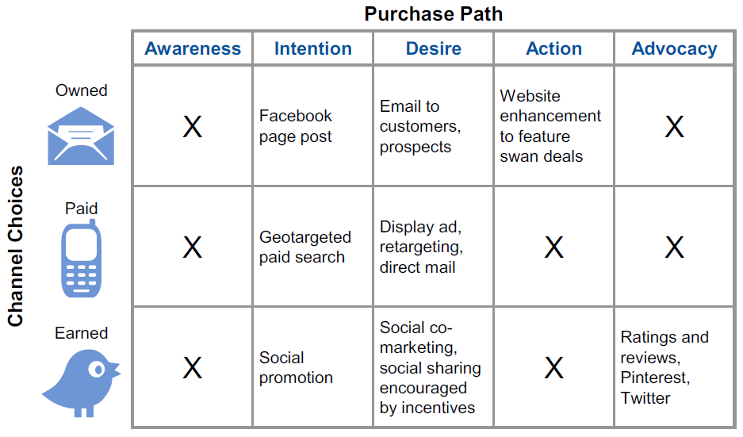
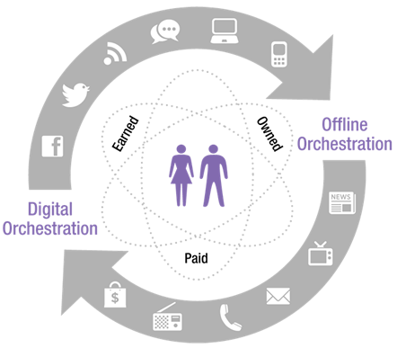
Campaign Channels
End to End Campaign to Cash Flow
Channel Types: Earned, Owned and Paid
Gartner’s Digital Orchestration Matrix
Confidential Property of Consumer Analytics Division, Tata Industries Limited

Slide 27




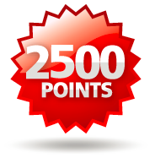




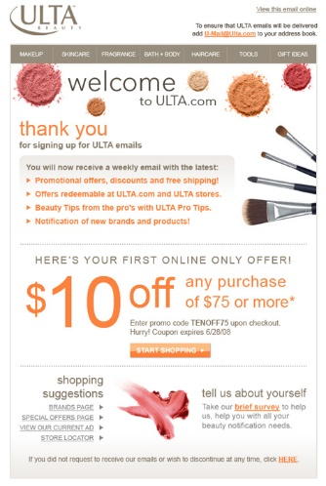



Email based campaigns
Types of personalized campaigns
Event
Triggered
Messages
Transactional Events
Order Welcome Shipping
Confirmation message Notification
Remarketing Events
Cart New
Abandonment Arrivals
Non Transactional Events
Rewards Birthday Warranty
Earned Notification Expiry
Batch & Blast
Email
Campaign
List Creation
Customer
Segmentation
Email Designing
Deliverability
Confidential Property of Consumer Analytics Division, Tata Industries Limited

Slide 28
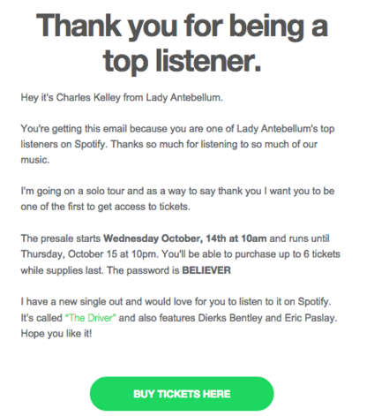
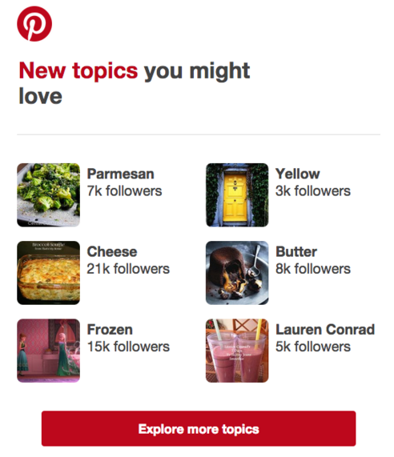

Email based campaigns
Personalized Email campaign with a message to cross-sell by Spotify
Personalized Recommendation based on user interest by Pinterest

Slide 29
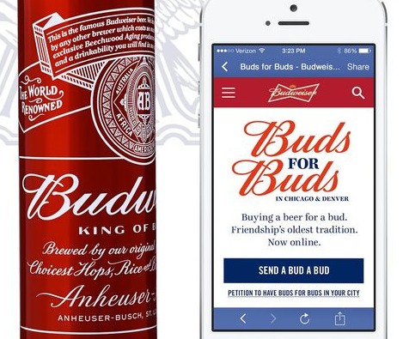
Case Study - Social Redemption Campaign
Budweiser’s campaign ‘Buds for Buds’ used Facebook’s ability to share moments with friends. It generated awareness and increased offline sales for Budweiser.
Business Goal : Awareness, drive traffic online and offline, and Sales.
Social Platform Used : Facebook Mobile App
Campaign Idea : The beer brand targeted people with friends in US with a promotion to buy a friend a beer with a redeemable receipt at a local bar
Result : 23 million earned media impressions and a threefold in-bar sales lift from consumers who spent more than the value of the first beer when redeeming their coupon
http://bcove.me/xdrjtoek

Slide 30
An Integrated View of Customer Behaviour

Slide 31
Power of Digital is exponential when combined with offline data

Slide 32
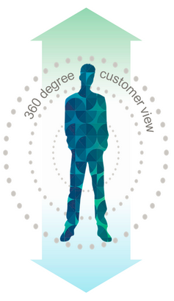





Integrated Customer Profile : Digital & Offline
Customized offering to customer based on browser history or historical purchase
Digital Footprint
Analytics Opportunity
Website Footprint
Online Behavior
Social Footprint
1
Store Recommendation
Demography
Relationship
Share of Wallet
2
Online Product Recommendation
Customer Profile
3
Personalized Offerings/Offer/Campaigns
4
Improve Loyalty Management
Store Locator
Loyalty/Membership
Purchase Frequency
Offline Footprint
Confidential Property of Consumer Analytics Division, Tata Industries Limited

Slide 33
Example 1 of Integrated View : Hospitality

Slide 34
Example 2 of Integrated View : Finance

Slide 37
Thank You

Slide 38
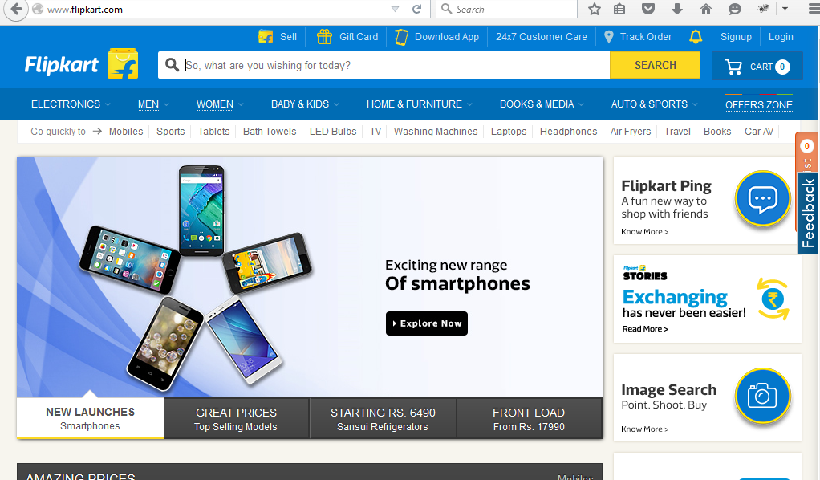
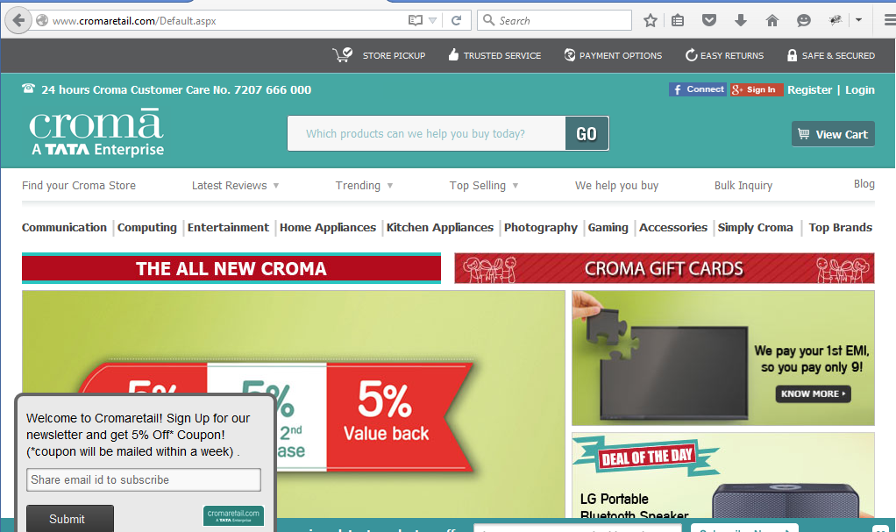
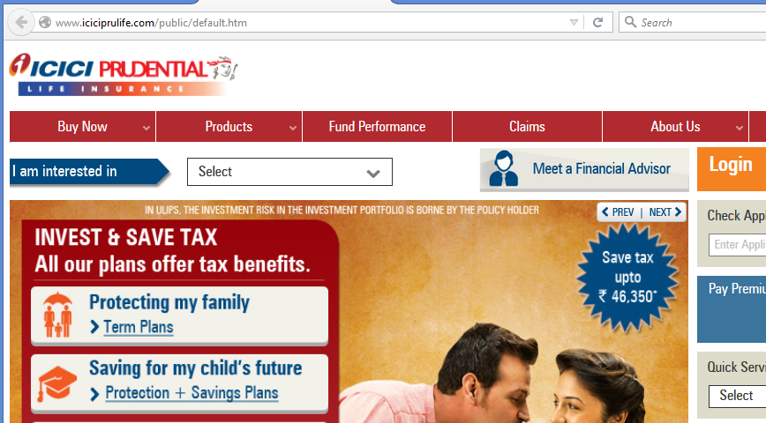



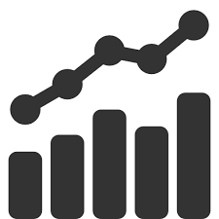
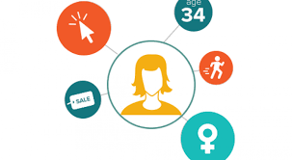



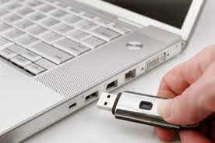



Threats to your Data can be Conventional or Innovative
Confidential Property of Tata Insights and Quants Division, Tata Industries Limited
Tata Companies Understand Conventional Threats to their Data
But Third Parties also have Innovative means to “Leverage” Your Data
Data of Multiple websites used
Company Data
By a third
Party
Co.2 Website
Co.1 Website
Co.3 Website
To Create an Online Aggregated Profile
External Threats
Hacks & Thefts
Internal Threats
For the Benefit of the Highest Bidder
$ 72 Billion
in Revenue
40 Million
# of Credit Cards Data stolen
Targeted
Display Ad
Are companies conscious of the impact of the threat?
Are companies conscious of the data they are giving up?

Slide 39
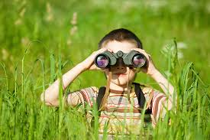


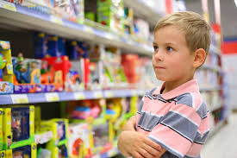

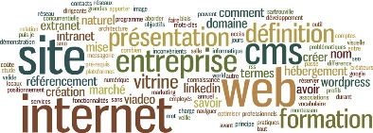




Digital Data is being created at an exponential rate
Confidential Property of Tata Insights and Quants Division, Tata Industries Limited
3.5 Billion
Searches on Google per day
2x
increase in "near me" search interest in 2015
100 million
hours of “how-to” content watched on YouTube in 2015
82%
of smartphone users consult their phones while in a store
30%
of Global population is active on Social Media
Tata iQ will capture the Digital Data that matters
Notes:
3.5 billion searches per day http://www.internetlivestats.com/google-search-statistics/#share
https://think.storage.googleapis.com/docs/4-new-moments-every-marketer-should-know.pdf, Google Trends, U.S., March 2015 vs. March 2014. 2x increase in "near me" search interest in the past year.
100 mn+ hours of “how-to” content have been watched on YouTube so far this year. Google Data, North America, January 1–May 5, 2015, "How-to" video classification based on public data such as headlines, tags, etc., and may not account for every "how-to" instructional video available on YouTube
Consumers in the Micro-Moment, Google/Ipsos, U.S., March 2015, n=5,398, based on internet users. 82% of smartphone users consult their phones while in a store deciding what to buy.
As for Social Media, there are over 2.206 Billion active users, a global penetration of 30%. - See more at: http://www.socialmediatoday.com/social-networks/kadie-regan/2015-08-10/10-amazing-social-media-growth-stats-2015#sthash.ZRsefNzs.dpuf

